Slide 1
Normal Distribution and Parameter Estimation

Slide 2
Continuous Probability Distributions
A continuous random variable is a variable that can assume any value on an interval
  thickness of an item, weight, length
  time required to complete a task
  temperature
  height, in inches
  miles per gallon

Slide 3
Probability Density
A function f(x) ≥ 0 that shows the more likely and less likely intervals of variable X.
P(a ≤ X ≤ b) = area under f(x) from a to b
f(X)
P
(
a
≤
X
≤
b
)
=
P
(
a
<
X
<
b
)
(Note that the probability of any individual value is zero)
a
b
X

Slide 4
The Normal Distribution
‘Bell Shaped’
Symmetrical
Mean, Median and Mode
are Equal
Location is determined by the mean, μ
Spread is determined by the standard deviation, σ
The random variable has an infinite theoretical range:
+ ∞ to − ∞
f(X)
σ
X
μ
Mean
= Median
= Mode

Slide 5
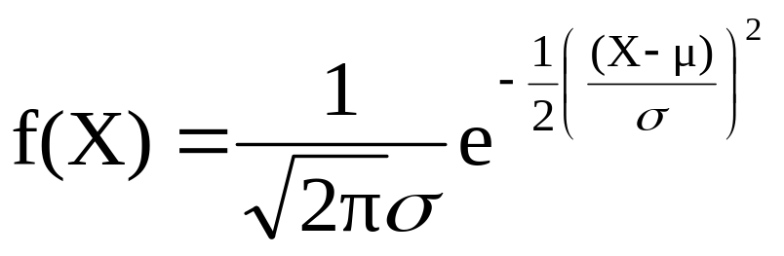
The Normal Distribution
Density Function
The formula for the normal probability density function is
Where e = the mathematical constant approximated by 2.71828
π = the mathematical constant approximated by 3.14159
μ = the population mean
σ = the population standard deviation
X = any value of the continuous variable

Slide 6
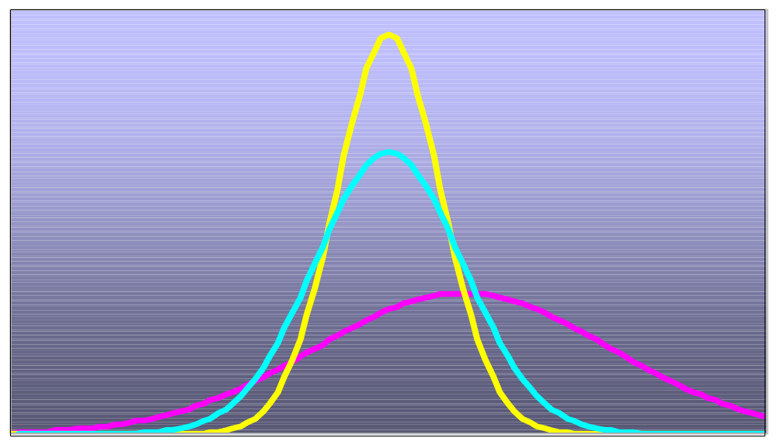
Many Normal Distributions
By varying the parameters μ and σ, we obtain different normal distributions

Slide 7
The Normal Distribution Shape
f(X)
Changing μ shifts the distribution left or right.
Changing σ increases or decreases the spread.
σ
μ
X

Slide 8
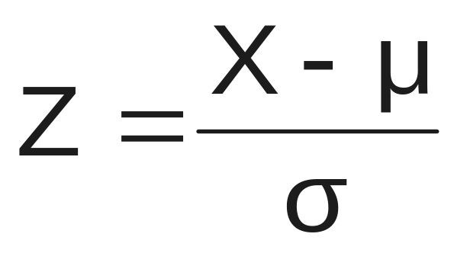
The Standardized Normal
Any normal distribution (with any mean μ and standard deviation σ) can be transformed into the standardized normal distribution (Z)
The standardized normal distribution (Z) has a mean of 0 and a standard deviation of 1

Slide 9
The Standardized
Normal Distribution
Also known as the “Z” distribution
Mean is 0
Standard Deviation is 1
f(Z)
1
Z
0
Values above the mean have positive Z-values, values below the mean have negative Z-values

Slide 10


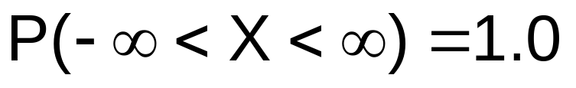
Probability as
Area Under the Curve
The total area under the curve is 1.0, and the curve is symmetric, so half is above the mean, half is below
f(X)
0.5
0.5
μ
X

Slide 11
The Standardized Normal Table
The Cumulative Standardized Normal table in the textbook (Appendix table E.2) gives the probability less than a desired value of Z (i.e., from negative infinity to Z)
0.9772
Example:
P(Z < 2.00) = 0.9772
0
2.00
Z

Slide 12
The Standardized Normal Table
(continued)
The column gives the value of Z to the second decimal point
Z 0.00 0.01 0.02 …
0.0
0.1
The row shows the value of Z to the first decimal point
.
.
.
The value within the table gives the probability from Z = − ∞ up to the desired Z value
2.0
.9772
P(Z < 2.00) = 0.9772
2.0

Slide 13
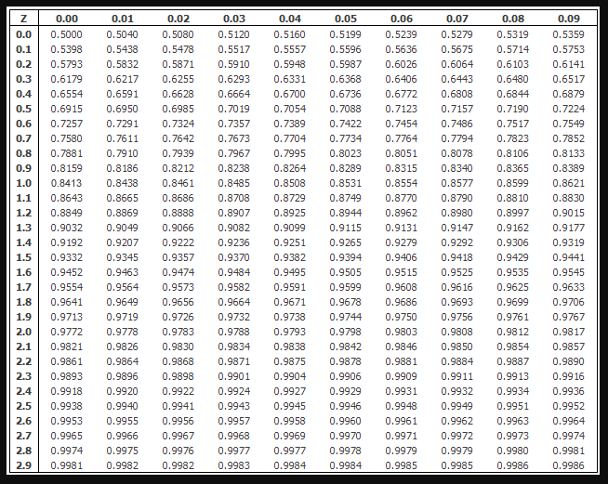

Slide 14
General Procedure for Finding Normal Probabilities
To find P(a < X < b) when X is distributed normally:
Draw the normal curve for the problem in
terms of X
Standardize X by computing Z
Use the Standardized Normal Table for Z

Slide 15
Example
Let X represent the time it takes (in seconds) to download an image file from the internet.
Suppose X is normal with a mean of 18.0 seconds and a standard deviation of 5.0 seconds. Find P(X < 18.6)
X
18.0
18.6

Slide 16
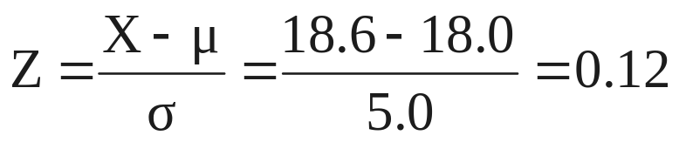
Finding Normal Probabilities
(continued)
Let X represent the time it takes, in seconds to download an image file from the internet.
Suppose X is normal with a mean of 18.0 seconds and a standard deviation of 5.0 seconds. Find P(X < 18.6)
μ = 18
σ = 5
μ = 0
σ = 1
18
18.6
X
0
0.12
Z
P(X < 18.6)
P(Z < 0.12)

Slide 18
Solution: Finding P(Z < 0.12)
Standardized Normal Probability
Table (Portion)
P(X < 18.6)
= P(Z < 0.12)
Z
.00
.01
.02
0.5478
0.0
.5000
.5040
.5080
0.1
.5398
.5438
.5478
0.2
.5793
.5832
.5871
Z
0.3
.6179
.6217
.6255
0.00
0.12

Slide 19
Finding Normal
Upper Tail Probabilities
Suppose X is normal with mean 18.0 and standard deviation 5.0.
Now Find P(X > 18.6)
X
18.0
18.6

Slide 20
Finding Normal
Upper Tail Probabilities
(continued)
Now Find P(X > 18.6) by the complement rule…
P(X > 18.6) = P(Z > 0.12) = 1.0 - P(Z ≤ 0.12)
= 1.0 - 0.5478 = 0.4522
0.5478
1.000
1.0 - 0.5478 = 0.4522
Z
Z
0
0
0.12
0.12

Slide 21
Probabilities in the Lower Tail
Suppose X is normal with mean 18.0 and standard deviation 5.0.
Find P(17.4 < X < 18)
X
18.0
17.4

Slide 22
Probabilities in the Lower Tail
(continued)
Find P(17.4 < X < 18)…
P(17.4 < X < 18)
= P(-0.12 < Z < 0)
= P(Z < 0) – P(Z ≤ -0.12)
= 0.5000 - 0.4522 = 0.0478
0.0478
0.4522
The Normal distribution is symmetric, so this probability is the same as P(0 < Z < 0.12)
17.4
18.0
X
-0.12
0
Z

Slide 23
“Empirical” Rules
What can we say about the distribution of values around the mean? For any normal distribution:
f(X)
μ ± 1σ encloses about 68.26% of X’s
σ
σ
X
μ-1σ
μ
μ+1σ
68.26%

Slide 24
The Empirical Rule
(continued)
μ ± 2σ covers about 95% of X’s
μ ± 3σ covers about 99.7% of X’s
2σ
2σ
3σ
3σ
μ
x
μ
x
95.44%
99.73%

Slide 25
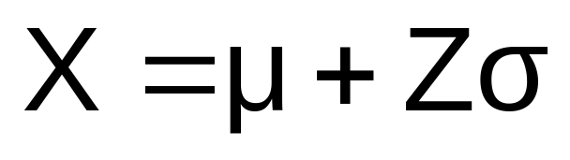
Given a Normal Probability
Find the X Value
Steps to find the X value for a known probability:
1. Find the Z value for the known probability
2. Convert to X units using the formula:

Slide 26
Finding the X value for a Known Probability
(continued)
Example:
Let X represent the time it takes (in seconds) to download an image file from the internet.
Suppose X is normal with mean 18.0 and standard deviation 5.0
Find X such that 20% of download times are less than X.
0.2000
?
18.0
X
?
0
Z

Slide 27
Find the Z value for
20% in the Lower Tail
1. Find the Z value for the known probability
Standardized Normal Probability
Table (Portion)
20% area in the lower tail is consistent with a Z value of -0.84
Z
…
.03
.04
.05
-0.9
…
.1762
.1736
.1711
0.2000
-0.8
…
.2033
.2005
.1977
-0.7
…
.2327
.2296
.2266
?
18.0
X
-0.84
0
Z
Chap 6-<number>

Slide 28
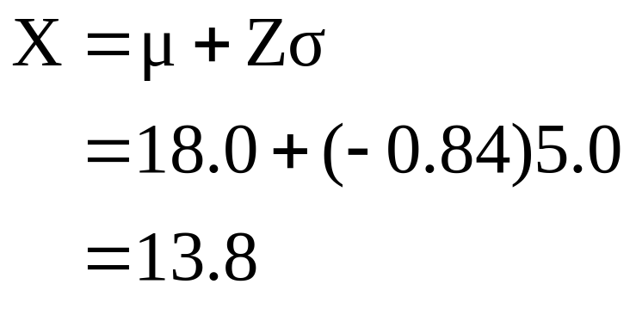
Finding the X value
2. Convert to X units using the formula:
So 20% of the values from a distribution with mean 18.0 and standard deviation 5.0 are less than 13.80

Slide 29
Excel commands
Normal probability
=NORM.DIST(x,mean,standard_dev,cumulative)
Normal inverse problem, value of X
=NORM.INV(probability,mean,standard_dev)
Cumulative=1 asks for a probability P(X ≤ x).
Cumulative=0 asks for a density f(x).

Slide 30
Parameter Estimation
and Sampling Distributions

Slide 31
Sampling Distributions
A sampling distribution is a distribution of a statistic computed from a sample of size n.
A sample is random, collected from a population. Hence, all statistics computed from it are random variables.

Slide 32



Example
Assume there is a population …
Population size N=4
Random variable, X,
is age of individuals
Values of X: 18, 20,
22, 24 (years)
D
A
B
C

Slide 33
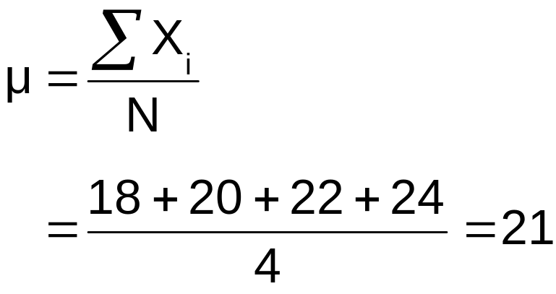
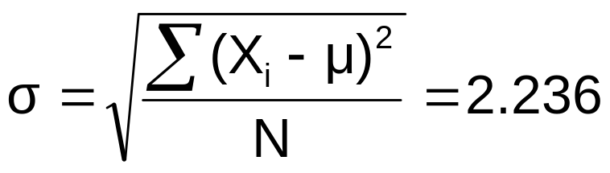
Example
(continued)
Population parameters:
P(x)
.3
.2
.1
0
18 20 22 24
A B C D
x

Slide 34
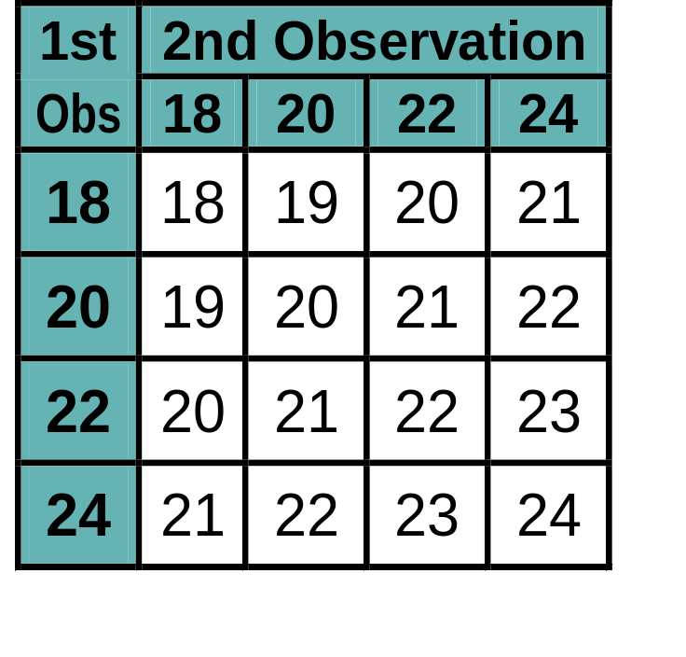
Now consider all possible samples of size n=2
Example
(continued)
16 Sample Means
1st Obs | 2nd Observation
 | 18 | 20 | 22 | 24
18 | 18,18 | 18,20 | 18,22 | 18,24
20 | 20,18 | 20,20 | 20,22 | 20,24
22 | 22,18 | 22,20 | 22,22 | 22,24
24 | 24,18 | 24,20 | 24,22 | 24,24
16 possible samples (sampling with replacement)

Slide 35

Sampling Distribution of All Sample Means
Example
(continued)
16 Sample Means
Sample Means Distribution
_
P(X)
.3
.2
.1
0
_
18 19 20 21 22 23 24
X
Chap 7-<number>

Slide 36
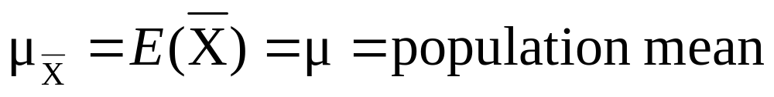
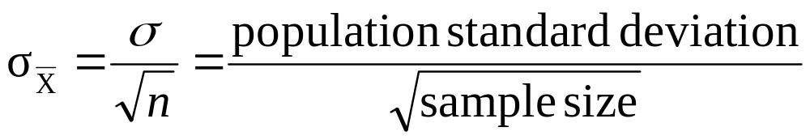
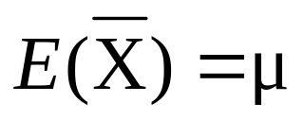
Sample mean has the following mean and standard deviation:
Sampling Distribution of the Sample Mean
Sample mean is unbiased because
Its standard deviation is also called the standard error of the sample mean. It decreases as the sample size increases.

Slide 37

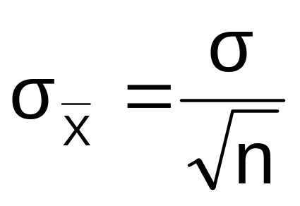
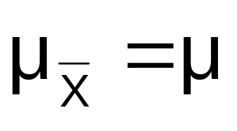
Sample Mean for a Normal Population
If a population is normal with mean μ and standard deviation σ, the sampling distribution of is also normal with
and

Slide 38
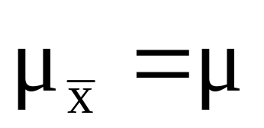


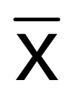

Sampling Distribution Properties
Normal Population Distribution
(i.e. is unbiased )
Normal Sampling Distribution
(has the same mean)

Slide 39
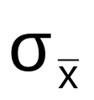

Sampling Distribution Properties
(continued)
  As n increases,
  decreases
Larger sample size
Smaller sample size

Slide 40
Sample Mean for non-Normal Populations
Central Limit Theorem:
  Even if the population is not normal,
  …sample means are approximately normal as long as the sample size is large enough.

Slide 41
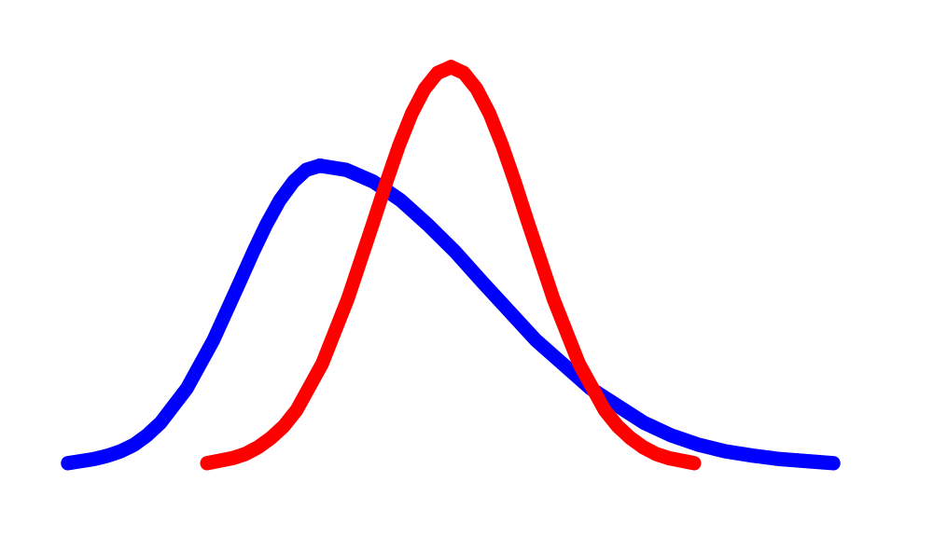
Central Limit Theorem
the sampling distribution of the sample mean becomes almost normal regardless of shape of population
As the sample size gets large enough…
n↑

Slide 42
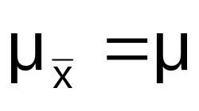

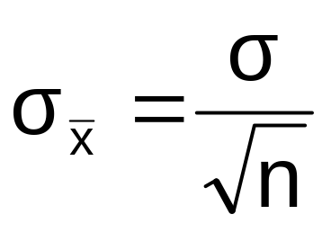

Sample Mean if the Population is not Normal
(continued)
Population Distribution
Sampling distribution properties:
Central Tendency
Variation
Sampling Distribution
(becomes normal as n increases)
Larger sample size
Smaller sample size

Slide 43
How Large is Large Enough?
For most distributions, n > 30 will give a sampling distribution that is nearly normal
For fairly symmetric distributions, n > 15
For normal population distributions, the sampling distribution of the mean is always normally distributed

Slide 44

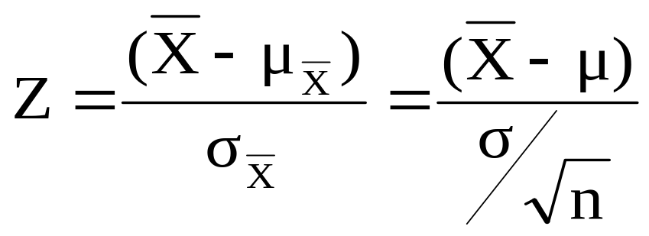



Z-value for Sampling Distribution of the Mean
Z-value for the sampling distribution of :
where: = sample mean
= population mean
= population standard deviation
n = sample size

Slide 45
Example
Suppose a population has mean μ = 8 and standard deviation σ = 3. Suppose a random sample of size n = 36 is selected.
What is the probability that the sample mean is between 7.8 and 8.2?

Slide 46


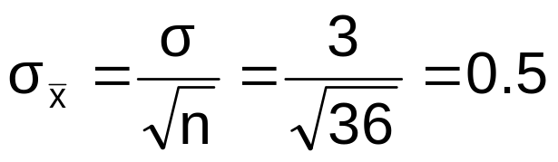
Example
(continued)
Solution:
Even if the population is not normally distributed, the central limit theorem can be used (n > 30)
… so the sampling distribution of is approximately normal
… with mean = 8
…and standard deviation

Slide 47
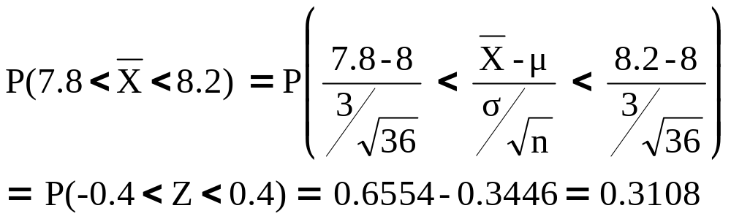




Example
(continued)
Solution (continued):
Population Distribution
Sampling Distribution
Standard Normal Distribution
?
?
?
?
?
?
?
?
?
?
Sample
Standardize
?
?
7.8 8.2
-0.4 0.4
Z
X

